Slide 1
Hack the dataset from X200GO:
3D modelling sensor
521479S Software project

Slide 2
Participants
Students
  Sami Häkkilä (sami.hakkila@student.oulu.fi)
  Syed Amin Al Mahim
  Muhammad Huzaifa (muhammad.huzaifa@student.oulu.fi)
Customer
  Rajesh Raveendran (rajesh.raveendran@oulu.fi)
  From University of Oulu

Slide 3
Agenda
Introduction
Milestones
Tasks
Tools
Progress
Risks & Challenges

Slide 4
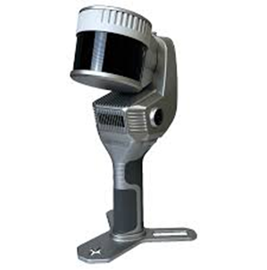
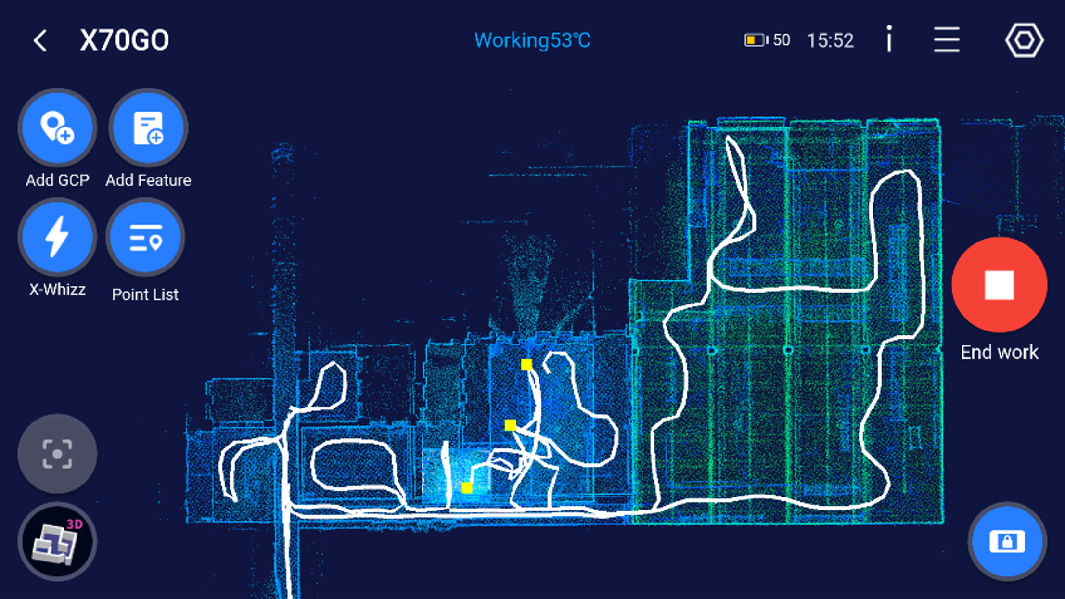
Introduction
X200GO:
  Advanced 3D modeling sensor.
  Captures spatial and positional data.
  Collected data is processed using the "manufacturer’s proprietary application" GoApp.

Slide 5
Introduction
Task:
  Decode the files generated by the sensor.
  Making them readable without GoApp.
  6 type of files, containing IMU data, Lidar data, GPS data and images raster files.
  ~in short reverse engineer the App!

Slide 6
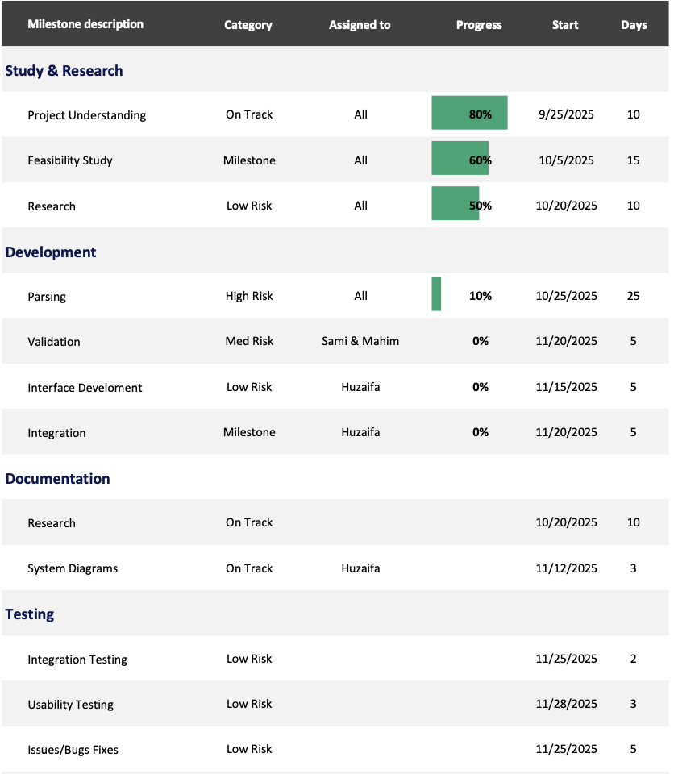
Milestones

Slide 7
Milestones
2025-09-25: Client Communication
2025-10-20: Study & Research
2025-11-25: Parsing/Decoding & Validation
2025-11-30: Interface Development & Integration
2025-12-10: Testing & Final Documentation
2025-12-10: Acceptance by customer -Final report delivered

Slide 8
Tasks
Member | Responsibility | Details
All Members | Study, Research, Testing & Documentation | Study sensor data structure, conduct research, test the parsing results, documentation and reports.
Sami Häkkilä | Data Parsing & Validation | Works on decoding and validating binary files (e.g., image raster or Lidar data), ensuring parsed results match ground truth values.
Syed Amin Al Mahim | Data Parsing & Validation
Muhammad Huzaifa | Data Parsing, Web Interface & Integration | Developing the web interface, integrating logic, and deployment.

Slide 9

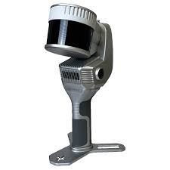


Tools
Hardware
  X200GO
Software
  Python:
    Great for initial development and testing, allows quick logic validation and data parsing via libraries.
    Ideal for handling binary data (IMU, Lidar, GPS, images).
  React JS:
    Easy to deploy and maintain — provides a lightweight, browser-based interface.
    Later validated Python logic will be converted to JavaScript for smooth integration.
  GitHub

Slide 10
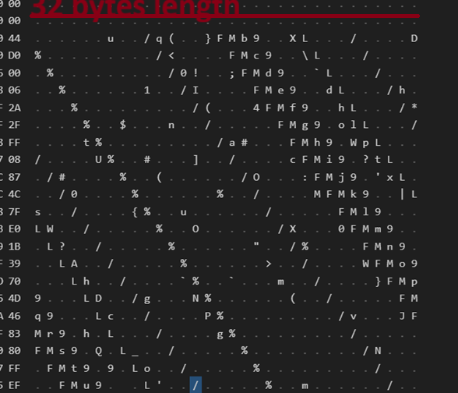
Progress (IMU-data)
Inspected the IMU-data with HEX-editor:
Findings:
  Header is 1024 bytes.
  Has a starting timestamp
  Data has a pattern!
    Repeating every 33 bytes.

Slide 11
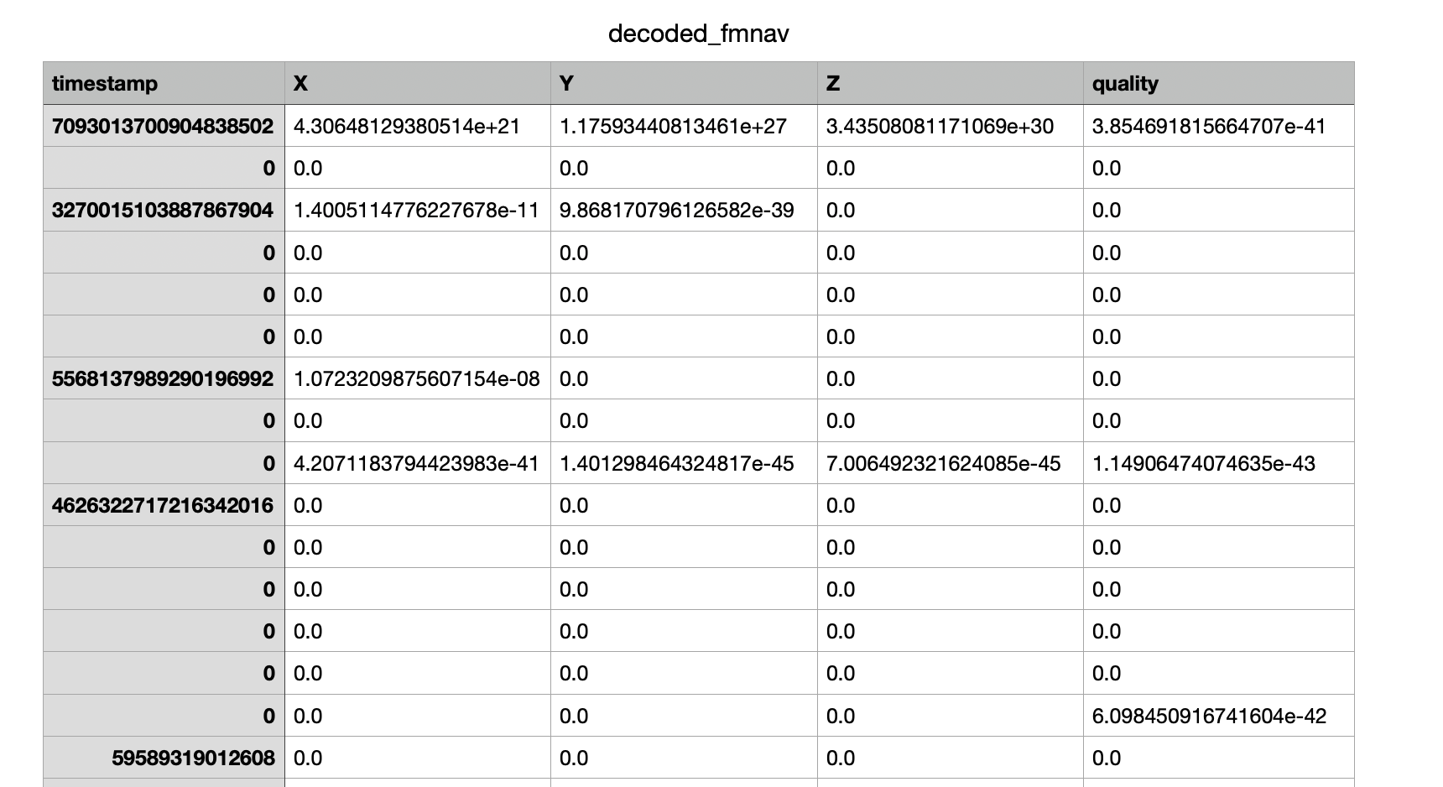
Progress (IMU-data)
Working on a first version of a Python script!
  Tries to find realistic accelerometer and gyroscope values:
  Tries little and big-endian orders.
  Test different data types, int16, float32 etc.

Slide 12
Risks / Challenges
What if?
  Manufacturer has intentionally obfuscated the data to make it difficult to decode.

Slide 13
Thank You

